Slide 1
<DATA STRUCTURES AND ALGORITHM>

Slide 2
I. INTRODUCTION

Slide 3
Data structures
A data structure is a particular way of organizing data in a computer so that it can be used effectively.

Slide 4
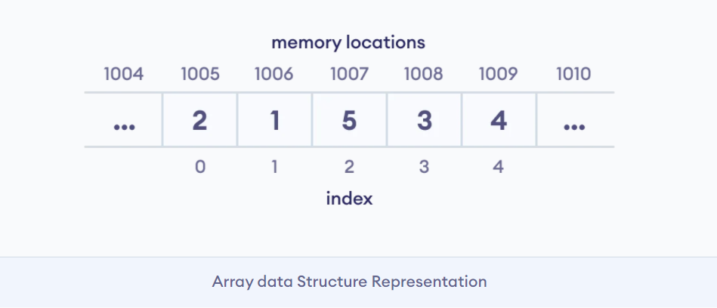
Depending on your requirement and project, it is important to choose the right data structure for your project. For example, if you want to store data sequentially in the memory, then you can go for the Array data structure.

Slide 5
TYPES OF Data structures
Linear data structure
Non-linear data structure

Slide 6
Linear Data structures
Elements are accessed in a sequential order but it is not compulsory to store all elements sequentially.
Examples: Arrays, Stacks and Queues.

Slide 7
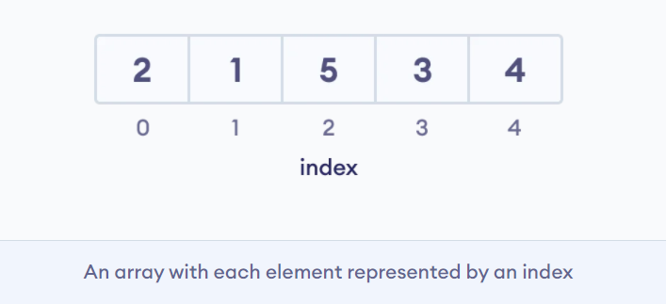
Example of linear data structure
Arrays: In an array, elements in memory are arranged in continuous memory. All the elements of an array are of the same type.

Slide 8
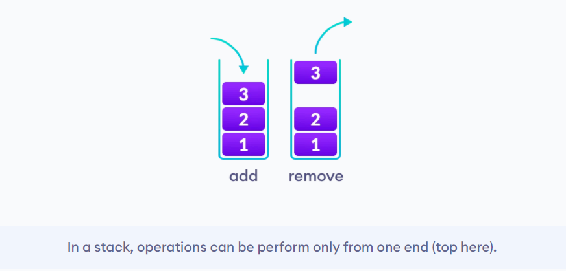
2. Stack: In stack data structure, elements are stored in the LIFO principle. That is, the last element stored in a stack will be removed first.

Slide 9
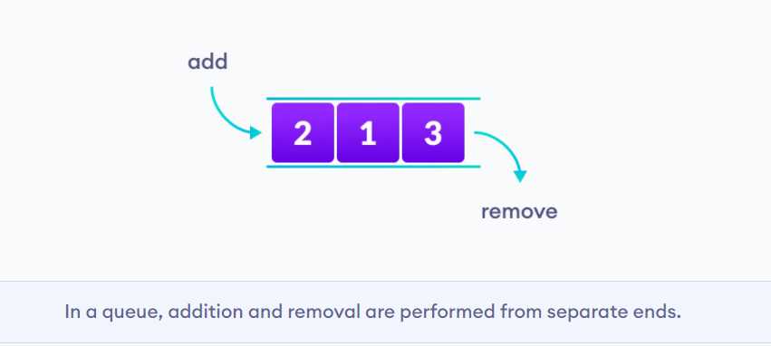
3. Queue: Unlike stack, the queue data structure works in the FIFO principle where first element stored in the queue will be removed first.

Slide 10
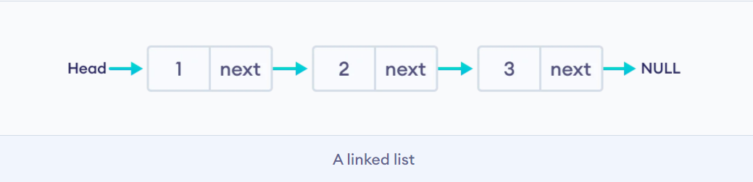
4. Linked List: In linked list data structure, data elements are connected through a series of nodes. And, each node contains the data items and address to the next node.

Slide 11
NON Linear Data structures
Unlike linear data structures, elements in non-linear data structures are not in any sequence. Instead they are arranged in a hierarchical manner where one element will be connected to one or more elements.
Examples: Trees and Graph.

Slide 12
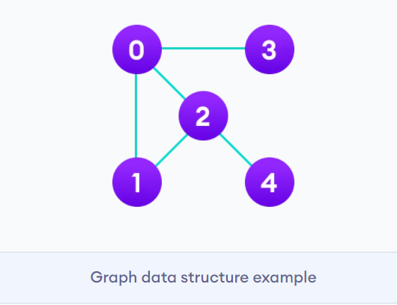
Example of non linear data structure
Graph: In graph data structure, each node is called vertex and each vertex is connected to other vertices through edges.

Slide 13
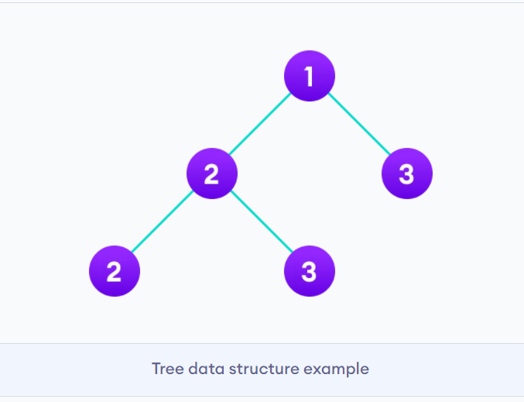
2. Trees: Tree data structure is an efficient way of storing the data in a hierarchical way.

Slide 14
ASSIGNMENT I
Give me a list of major difference between linear and non linear data structures.

Slide 15
ALGORITHM
Algorithm refers to a set of rules/instructions that step-by-step define how a work is to be executed upon in order to get the expected results.

Slide 16
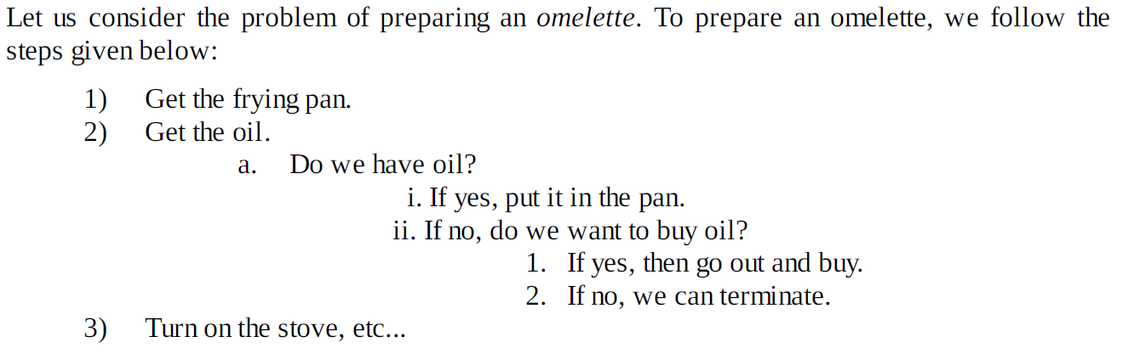
What is an Algorithm?

Slide 17
QUALITIES OF GOOD ALGORITHMS
Input and output should be defined precisely.
Each step in the algorithm should be clear and unambiguous.
Algorithms should be most effective among many different ways to solve a problem.
An algorithm shouldn't include computer code. Instead, the algorithm should be written in such a way that it can be used in different programming languages.

Slide 18
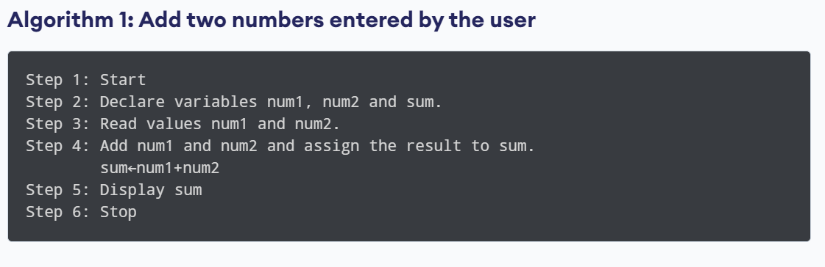
EXAMPLES OF ALGORITHMS

Slide 19
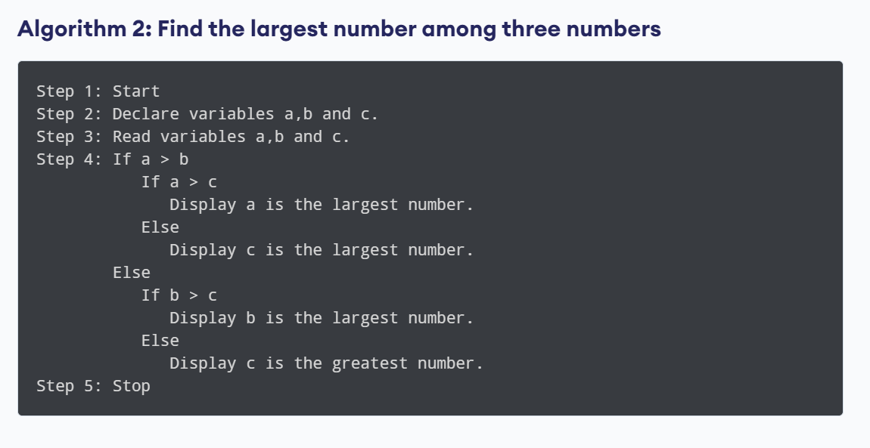

Slide 20
EXERCISE
Write an algorithm to read a number and print if the number is even or odd.
Given the sides of a parallelogram, write an algorithm to determine if the type is a square or a rectangle.

Slide 21
There are two main criteria for judging the merits of algorithms:
Correctness (does the algorithm give solution to the problem in a finite number of steps?)
Efficiency (how much resources (in terms of memory and time) does it take to execute it).

Slide 22
Why the Analysis of Algorithms?
To go from city “A” to city “B”, there can be many ways of accomplishing this: by flight, by bus, by train and also by bicycle. Depending on the availability and convenience, we choose the one that suits us. Similarly, in computer science, multiple algorithms are available for solving the same problem (for example, a sorting problem has many algorithms, like insertion sort, selection sort, quick sort and many more). Algorithm analysis helps us to determine which algorithm is most efficient in terms of time and space consumed.

Slide 23
How to Compare Algorithms
To compare algorithms, let us define a few objective measures:
Execution times? Not a good measure as execution times are specific to a particular computer.
Number of statements executed? Not a good measure, since the number of statements varies with the programming language as well as the style of the individual programmer.
We need a comparison which is independent of machine time, programming style, etc.

Slide 24
Algorithm COMPLEXITY
Suppose X is an algorithm and n is the size of input data, the time and space used by the algorithm X are the two main factors, which decide the efficiency of X.
Space Complexity
Time Complexity

Slide 25
SPACE COMPLEXITY
Space complexity of an algorithm represents the amount of memory space required by the algorithm in its life cycle. The space required by an algorithm is equal to the sum of the following two components:
A fixed part that is a space required to store certain data and variables, that are independent of the size of the problem. For example, simple variables and constants used, program size, etc.
A variable part is a space required by variables, whose size depends on the size of the problem. For example, dynamic memory allocation, recursion stack space, etc.

Slide 26
tIME COMPLEXITY
Time complexity of an algorithm represents the amount of time required by the algorithm to run to completion.

Slide 27
Types of Analysis
To analyze the given algorithm, we need to know with which inputs the algorithm takes less time(performing well) and with which inputs the algorithm takes a long time.
That means we represent the algorithm with multiple expressions: one for the case where it takes less time and another for the case where it takes more time.

Slide 28
Types of Analysis
In general, the first case is called the best case and the second case is called the worst case for the algorithm. To analyze an algorithm we need some kind of syntax, and that forms the base for asymptotic analysis/notation. There are three types of analysis:

Slide 29
Types of Analysis
Worst case: Defines the input for which the algorithm takes a long time (slowest time to complete). Input is the one for which the algorithm runs the slowest.
Best case: Defines the input for which the algorithm takes the least time (fastest time to complete). Input is the one for which the algorithm runs the fastest.
Average case: Provides a prediction about the running time of the algorithm. Run the algorithm many times, using many different inputs that come from some distribution that generates these inputs, compute the total running time (by adding the individual times), and divide by the number of trials.

Slide 30
Asymptotic Analysis
The efficiency of an algorithm depends on the amount of time, storage and other resources required to execute the algorithm. The efficiency is measured with the help of asymptotic notations.
An algorithm may not have the same performance for different types of inputs. With the increase in the input size, the performance will change.
The study of change in performance of the algorithm with the change in the order of the input size is defined as asymptotic analysis.

Slide 31
Asymptotic Notations
Asymptotic notations are the mathematical notations used to describe the running time of an algorithm when the input tends towards a particular value or a limiting value.
For example: In sort, when the input array is already sorted, the time taken by the algorithm is linear i.e. the best case. But, when the input array is in reverse condition, the algorithm takes the maximum time (quadratic) to sort the elements i.e. the worst case.

Slide 32
Asymptotic Notations
There are mainly three asymptotic notations:
Big-O notation
Omega notation
Theta notation

Slide 33
Big-O Notation (O-notation)
The notation Ο(n) is the formal way to express the upper bound of an algorithm's running time. It measures the worst case time complexity or the longest amount of time an algorithm can possibly take to complete.

Slide 34
Omega Notation (Ω-notation)
The notation Ω(n) is the formal way to express the lower bound of an algorithm's running time. It measures the best case time complexity or the best amount of time an algorithm can possibly take to complete.

Slide 35
Theta Notation (Θ-notation)
Theta notation encloses the function from above and below. Since it represents the upper and the lower bound of the running time of an algorithm, it is used for analyzing the average-case complexity of an algorithm.

Slide 36
REFERENCES
Data Structures And Algorithms Made Easy: Data Structures And Algorithmic Puzzles by Narasimha Karumanchi
https://www.programiz.com
https://www.tutorialspoint.com

